Slide 1
Asian Longhorned Beetle
July 2020
Anoplophora glabripennis
Steven Valley, OR Dept of Agriculture, Bugwood.org

Slide 2
Overview
Native to mainland eastern China and Korea
Found in the US in 1996; likely introduced as a contaminant in solid wood packaging materials
US hosts include maple, poplar, willow, elm, birch, and many more
Attacks healthy and stressed trees
Found in New York, Massachusetts, Ohio, and most recently South Carolina
Eradicated from Illinois, New Jersey, and Canada
Dennis Haugen, USDA Forest Service, Bugwood.org

Slide 3
Life Cycle
Overwintering stages
7-14 days
Generally overwinter as mature larvae
Generations take 1-2 years*
10-14 days
1-2 years
*Development is temperature dependent, warmer climates will take one year, colder climates will take two years
Eggs - Pest and Diseases Image Library, Bugwood.org
Larva - Pest and Diseases Image Library, Bugwood.org
Pupa - PA Dept of Conservation and Natural Resources - Forestry, Bugwood.org
Adult - Steven Valley, Oregon Department of Agriculture, Bugwood.org
Mating - Melody Keena, USDA Forest Service, Bugwood.org
13-24 days

Slide 4
Eggs
Laid during spring-summer
Up to 90 laid in a lifetime
One egg per bark notch (also called an egg scar)
Notches are chewed into the bark of trees by females before ovipositing
Hatching is temperature dependent, generally occurs in 7-14 days
Dennis Haugen, USDA Forest Service, Bugwood.org

Slide 5
Larvae
Larvae develop through at least five instars
Larvae require 1-2 years to complete development
They start in the tree cambium and move into the heartwood over time
Overwintering generally occurs in the larval stage
Yellow-white, up to 2 in. long and 0.25 in. wide, with a dark brown head capsule
Steven Katovich, Bugwood.org

Slide 6
Pupa
Pupation occurs during spring
Inhabit frass filled chambers constructed in larval galleries
Pupation usually takes 13-24 days before emerging as adults
Kenneth R. Law, USDA APHIS PPQ, Bugwood.org

Slide 7
Adults
Adults emerge from the tree spring-fall
They leave through a 0.4 in. round exit hole they chew through the bark
Their body is 0.75-1.5 in. long
Adults live 50-60 days, with males shorter lived
They generally feed on leaves and cambium of small twigs
Joe Boggs, Ohio State University, Bugwood.org
Gillian Allard, FAO of United Nations, Bugwood.org

Slide 8
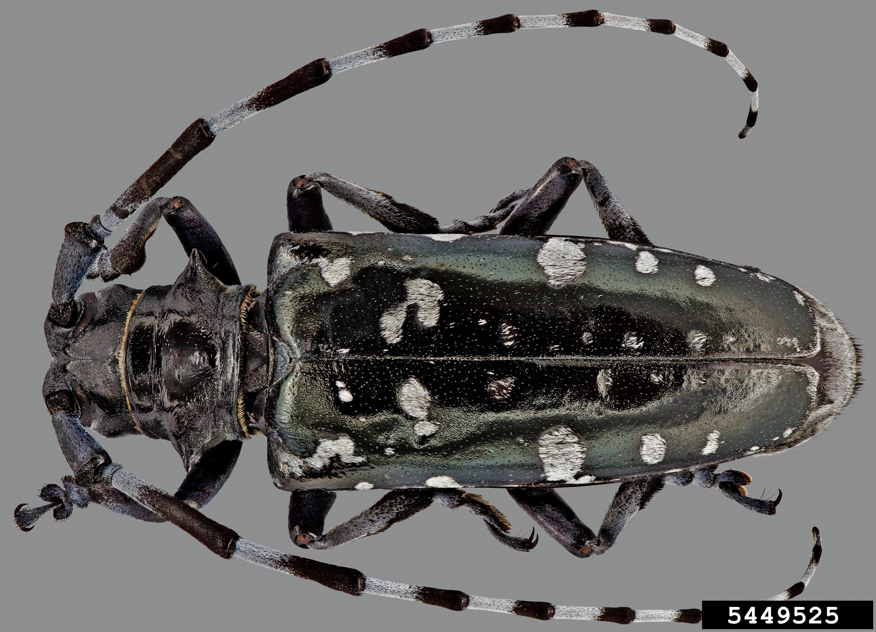
Identifying Characteristics
Key ID characteristics include:
Size
Color
Hosts
Female antennae are as long as their body, Male antennae are much longer
Antenna banded black and white
Body glossy black with white spots
Feet have a bluish color
Black scutellum
Steven Valley, OR Dept of Agriculture, Bugwood.org

Slide 9
Damage and Control
Damage indicators include crown defoliation and death, heavy accumulation of sawdust at base of trunk and in branch crotches, exit holes in the bark, and galleries when the bark is removed
Treatments have included trunk and soil insecticide injections
More often, trees are removed after infestation
Removed trees are often chipped to prevent eggs and larvae from moving from one place to another
Thomas B. Denholm, NJ Dept of Agriculture, Bugwood.org
Thomas B. Denholm, NJ Dept of Agriculture, Bugwood.org

Slide 10
Pathways
Wood movement
Wood packing
Cut wood/Lumber
Timber movement
Firewood
Tree debris removal (stumps, branches, etc.)
Live plant movement

Slide 11
Who to contact
County Extension Office
https://extension.uga.edu/county-offices.html
County Forester
https://gatrees.org/about/county-contacts/

